Slide 1
E-Commerce Website
Dry Fruits Purchasing
(Frontend- Reactjs & Backend- Springboot)
Submitted by, Sinthuja L

Slide 2
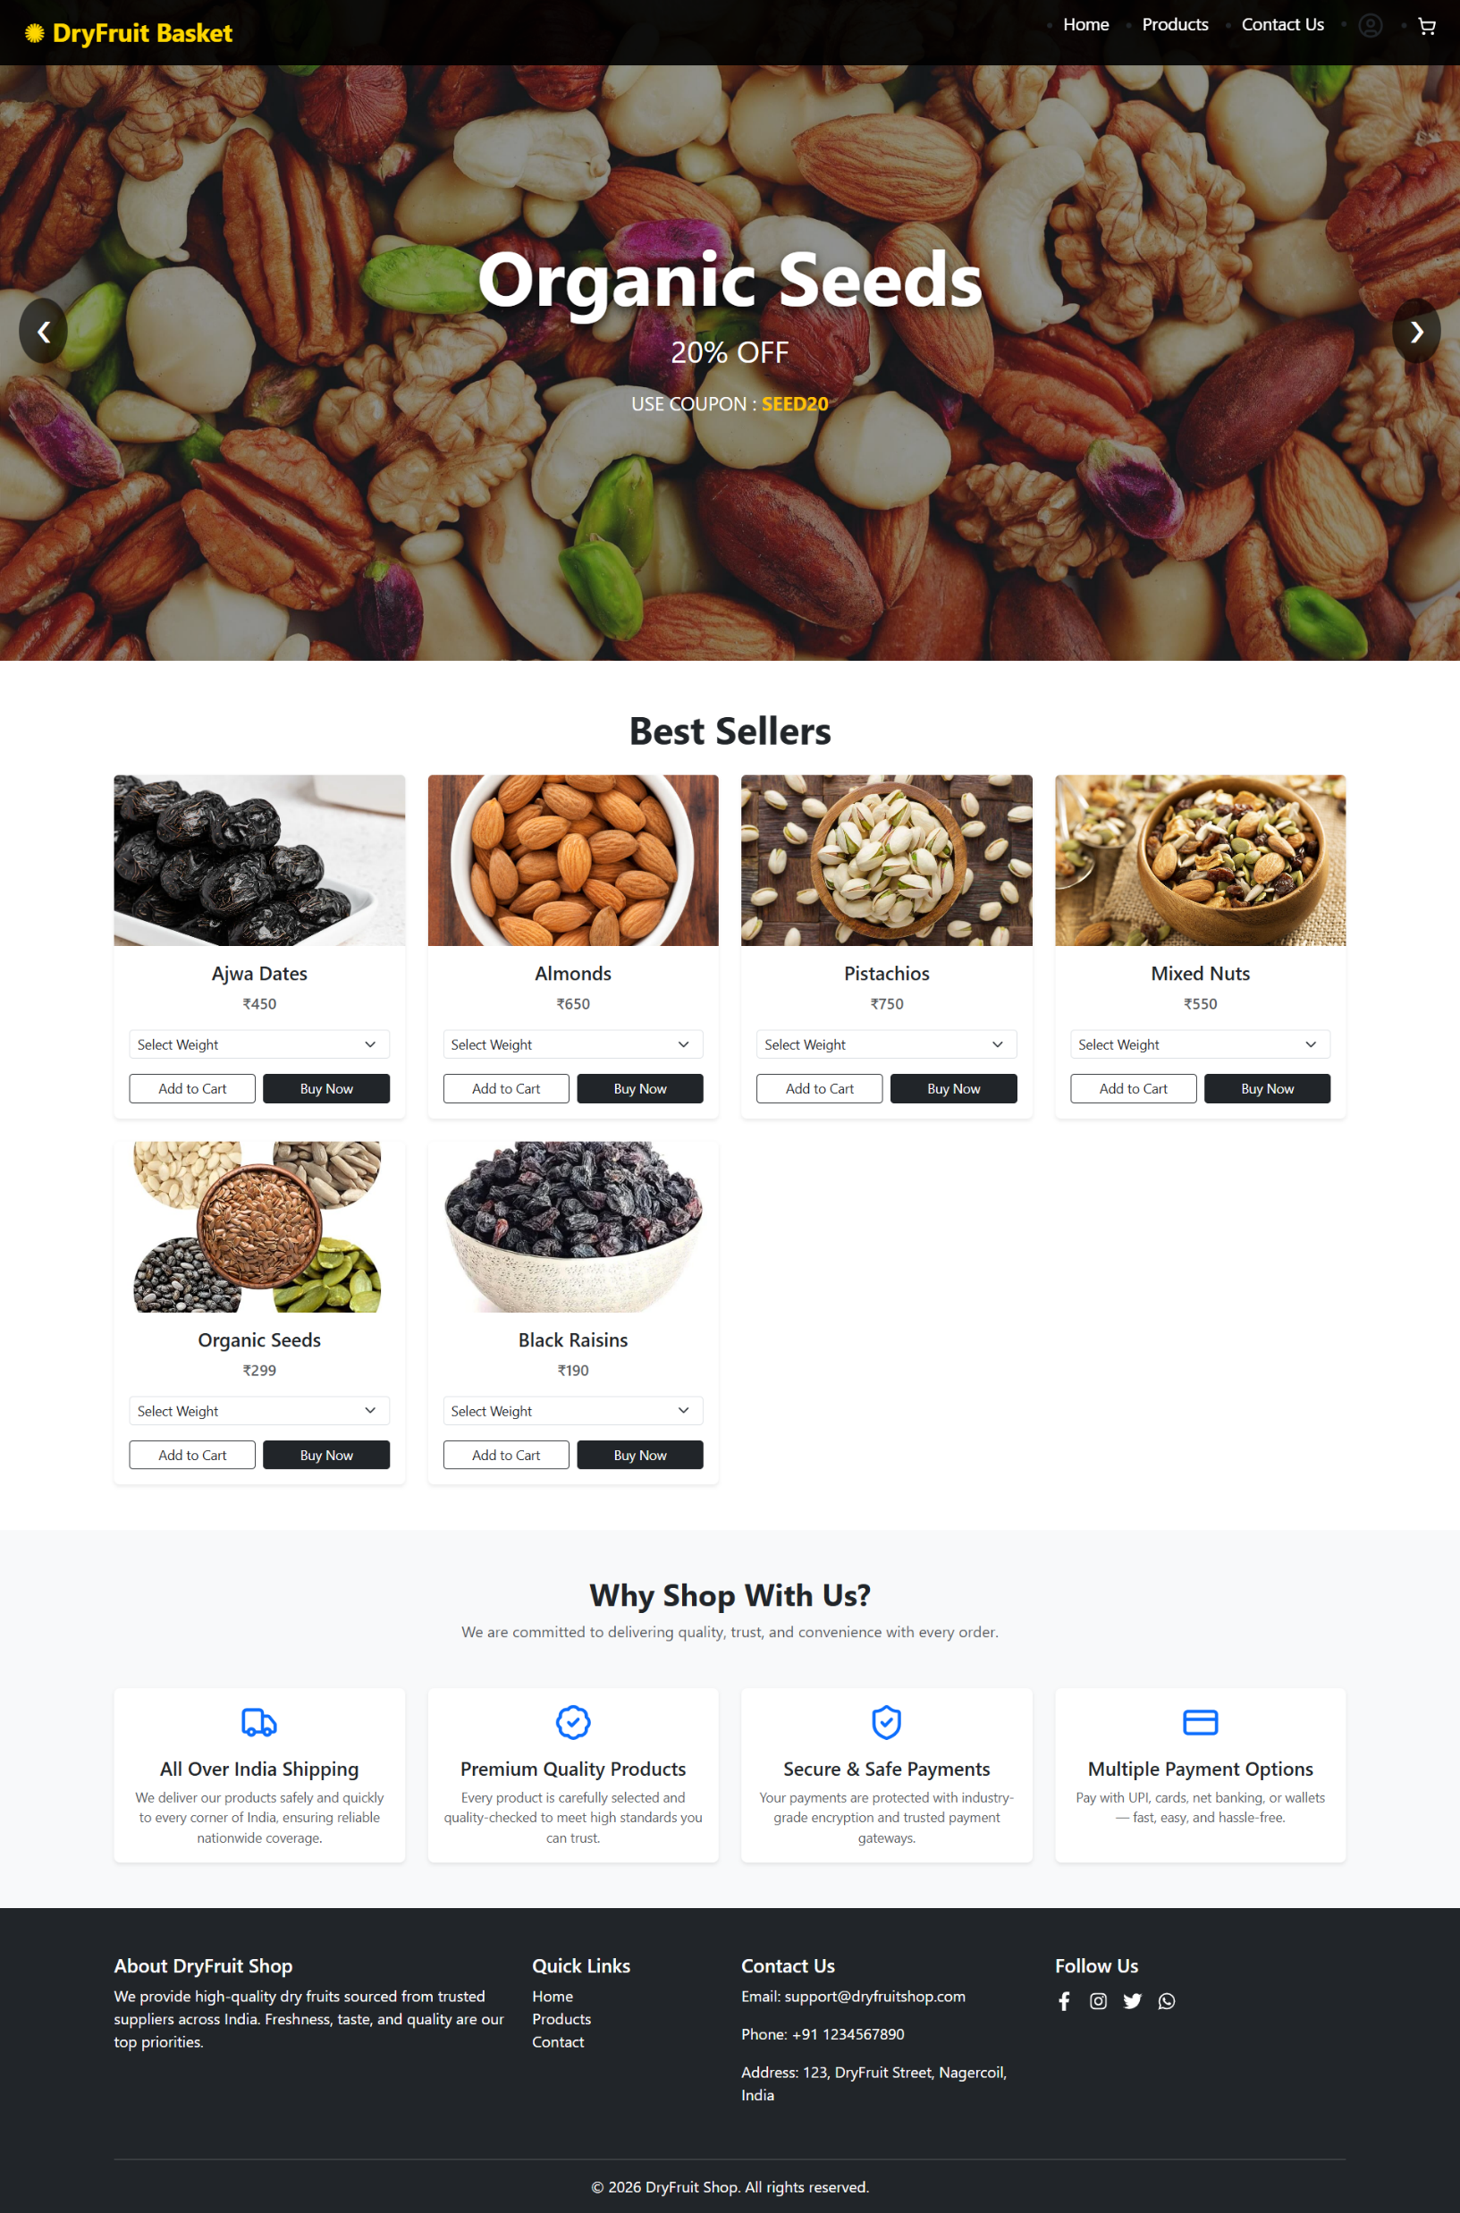
Home Page

Slide 3
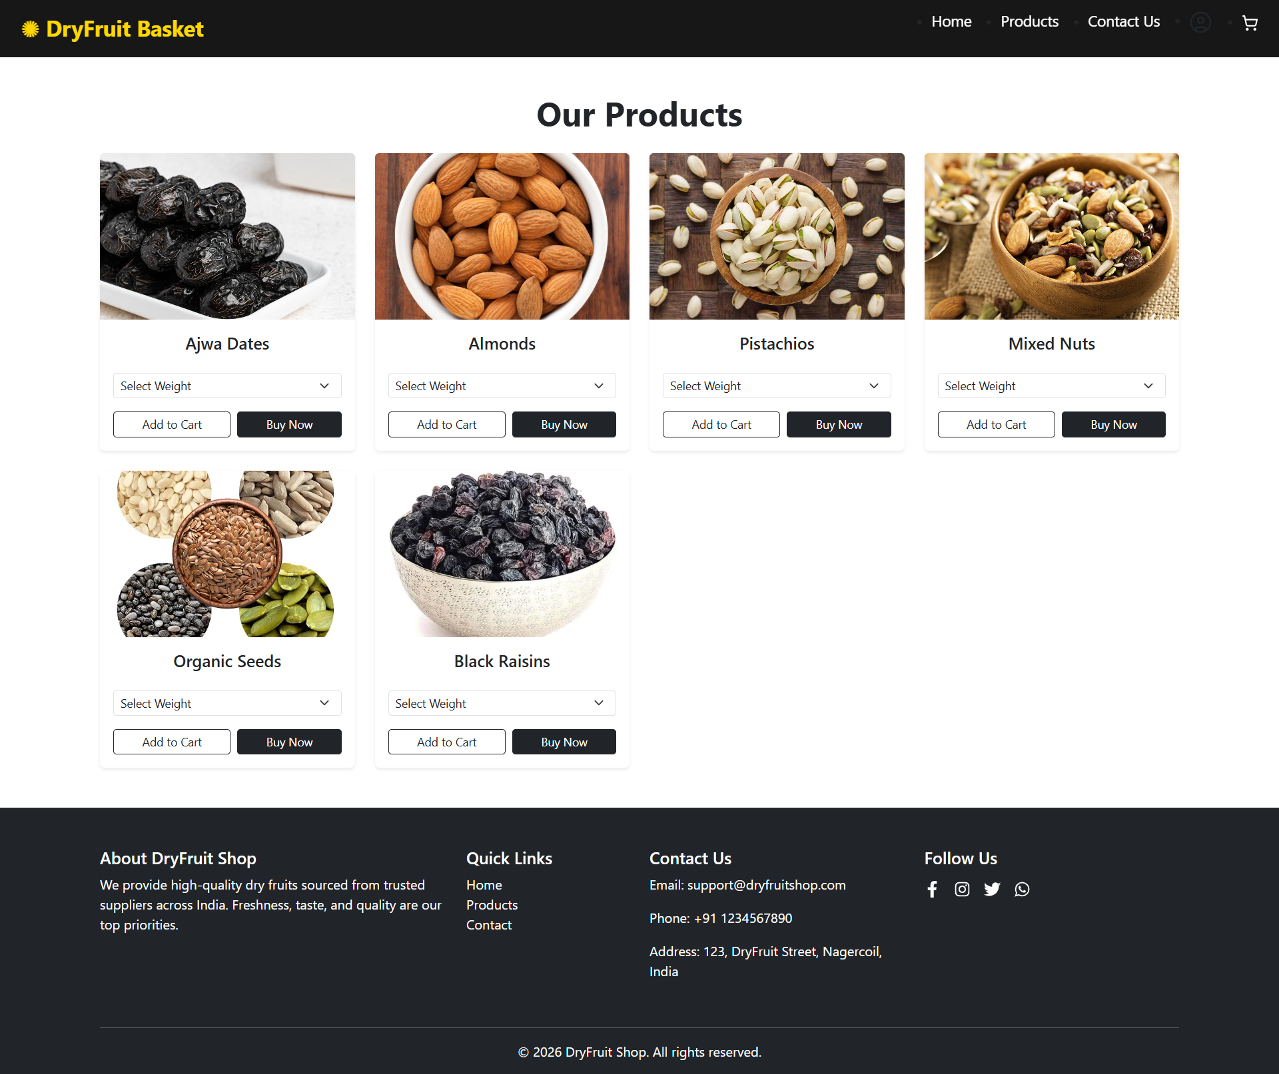
Product Page

Slide 4
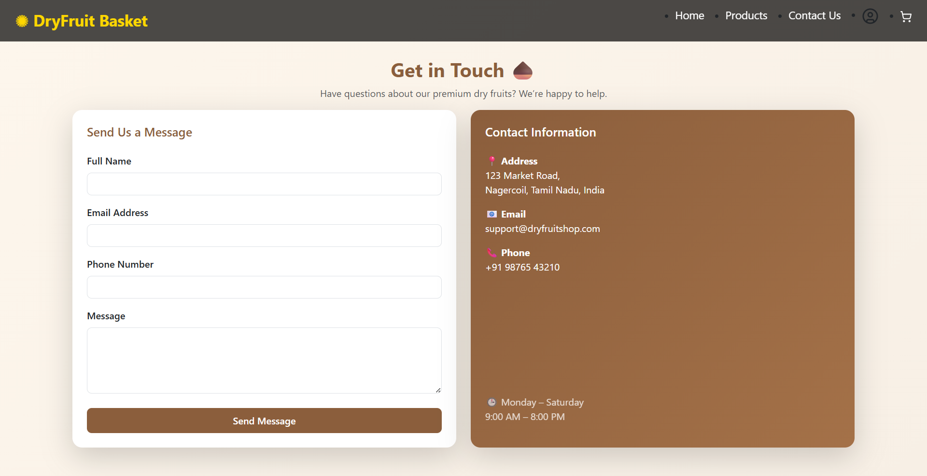
Contact us Page

Slide 5
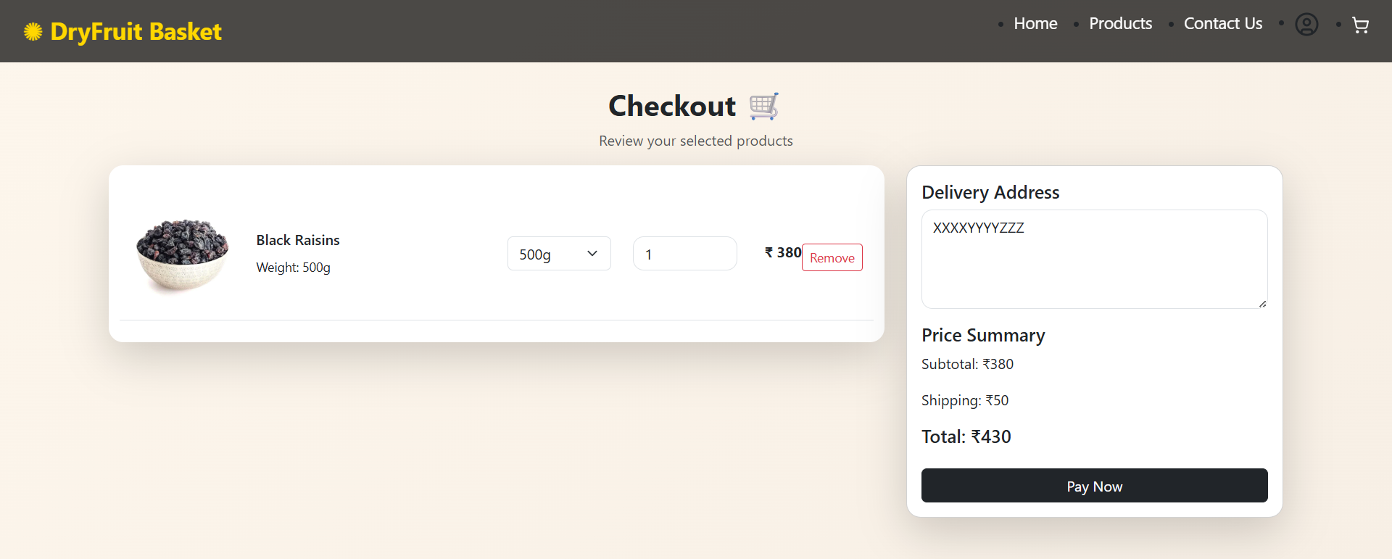
Checkout Page Here, the products are inserted if they click add to cart or buynow. Now,enter the address and click pay to order the items

Slide 6
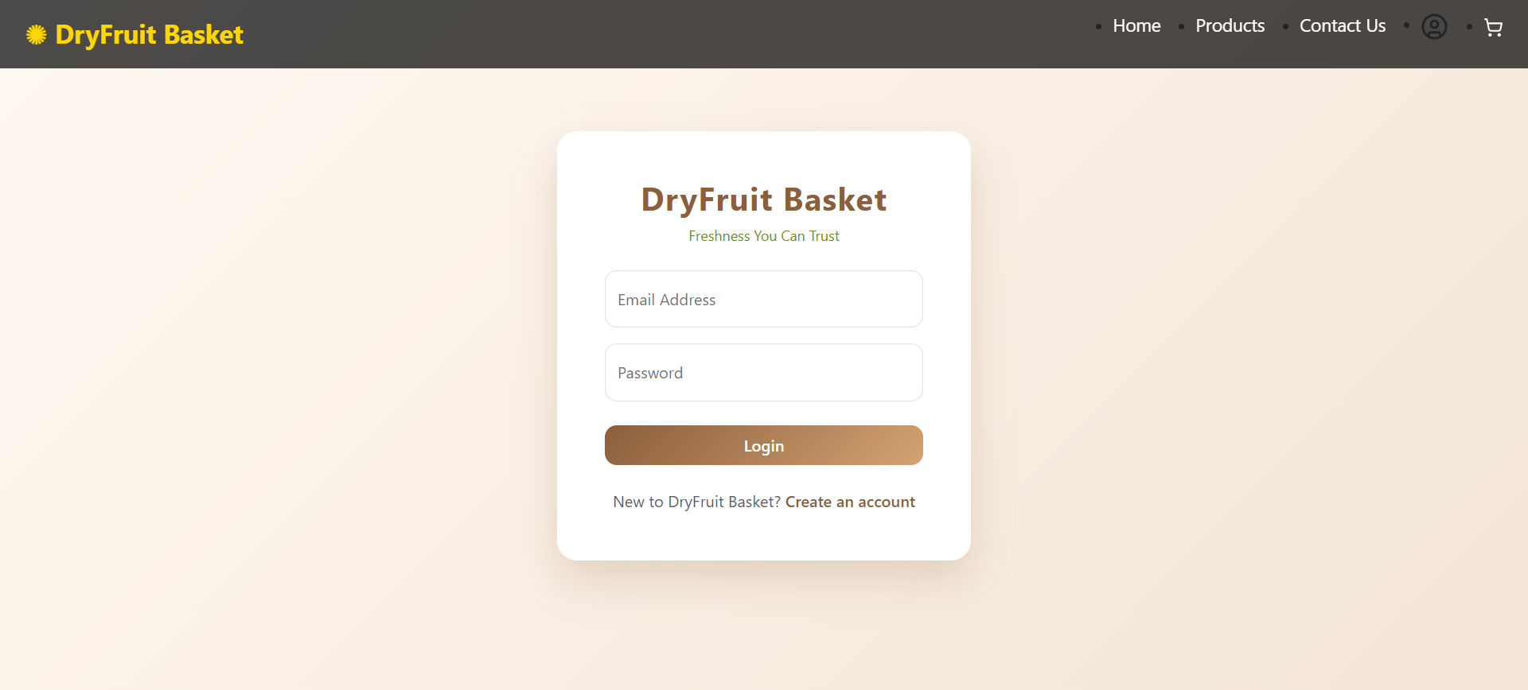
Login Page If the user want to order the items, should Logged in ,If not user is Logged In then it will redirect to Login Page

Slide 7
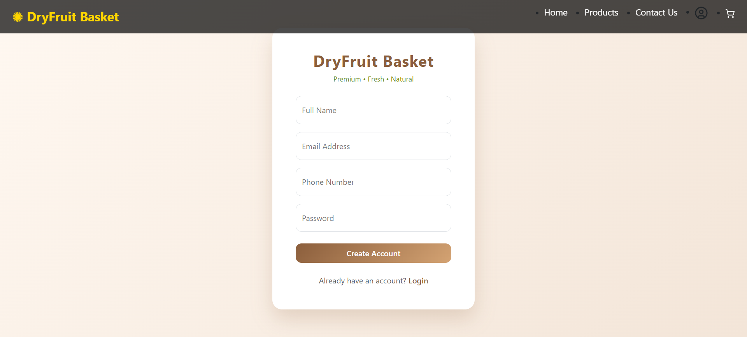
Register Page

Slide 8
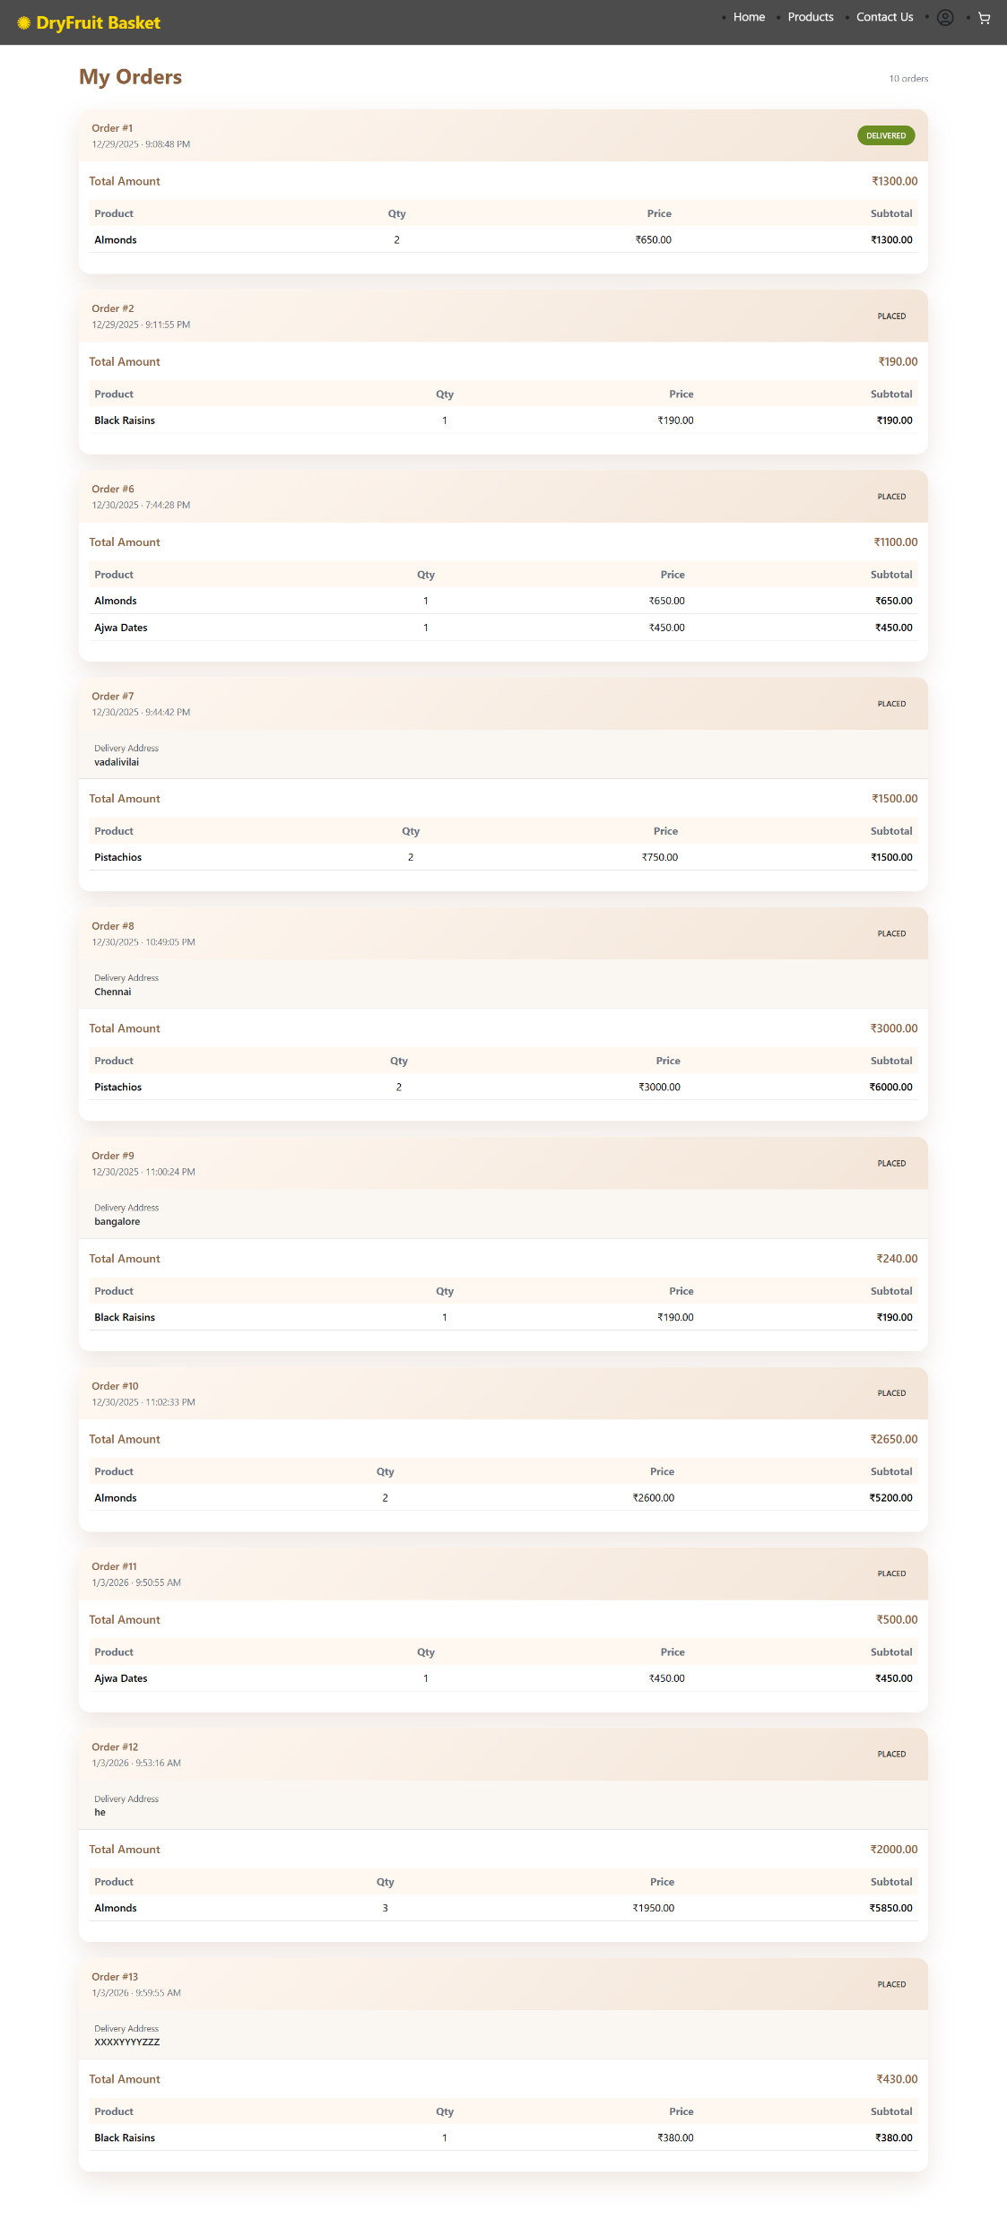
Orders Page

Slide 9
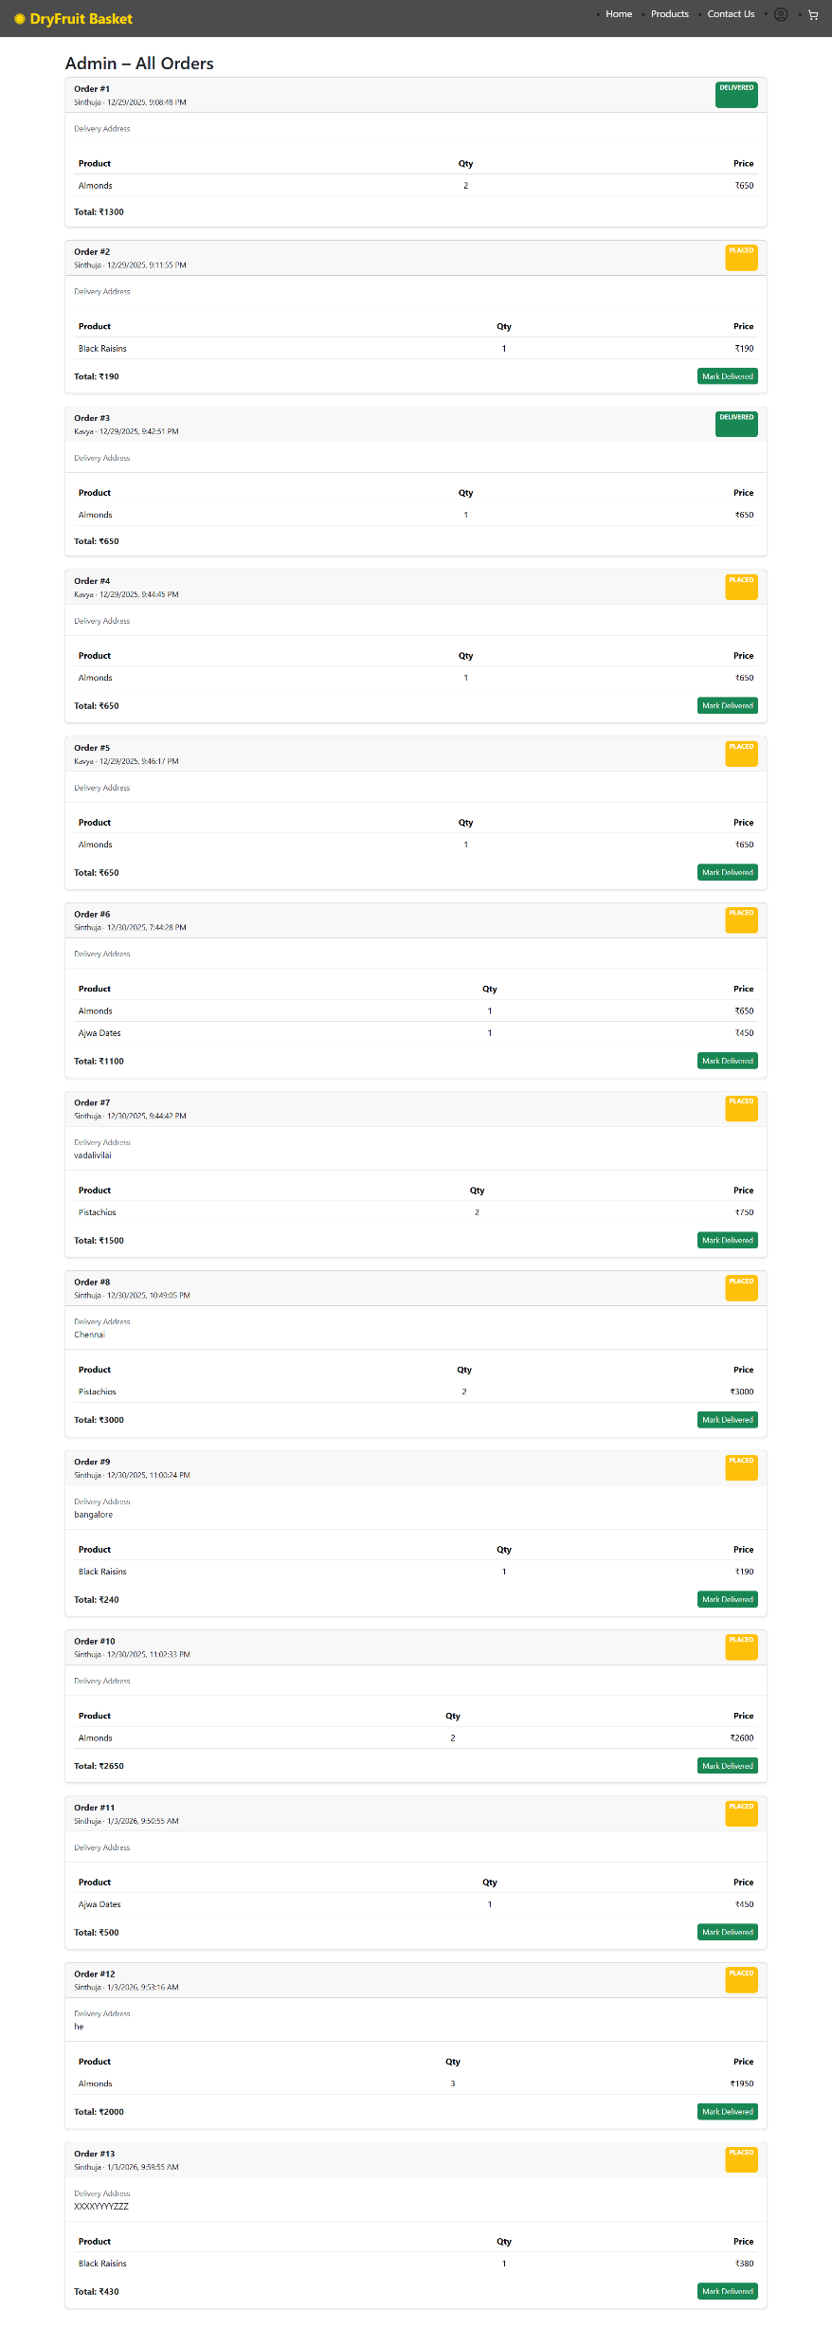
Admin Panel To show the orders to the admin

